Slide 1
Reception
Nagraj And Sudeepa
PPT for Event ID: 9
Date: 2025-10-10

Slide 2
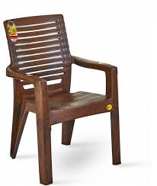
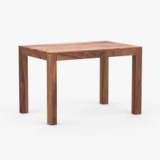
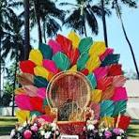
Category: Furniture
chair
table
chair
₹2000.00 x 50
₹200.00 x 15
₹500.00 x 1

Slide 3
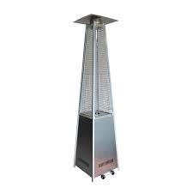
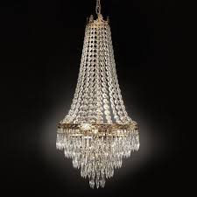
Category: Decor
Pyramid heater
Jhoomar
₹3000.00 x 10
₹2000.00 x 3

Slide 4
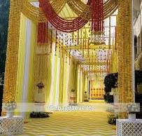
Category: Entrance
Haldi Entrance
₹30000.00 x 1

Slide 5

Category: Services
Russian Dancer
₹6000.00 x 20

Slide 6
Quotation Summary
Total Cost: ₹289500.00

